Slide 1

Under and Over-valued MLB Players: A Machine Learning Approach
Nicholas Sullivan

Slide 2
Goals
Create a way to evaluate and compare players in the MLB based on performance and salary
Use this to make decisions on whether players should be signed/re-signed, cut, or promoted from the minors
Establish comfortability using machine learning techniques in R, and working with different baseball data in an advanced analytical manner
Rely on visualizations to tell the story

Slide 3
Analytical Approach
Use Machine Learning techniques to build a system that groups players into under-valued, correctly valued, and over-valued based on performance and salary
Research what collection of traditional and advanced statistics and metrics are best for determining a player’s value
Multiclass classification with possible effective algorithms being K-means clustering, hierarchical clustering, and Support-vector machine (SVM)

Slide 4
Data
Salary Data¹ – 2022 beginning of season salary data
Baseball Savant² – Complete 2021 season traditional and advanced statistics for pitchers with at least 100 pitches and batters with at least 250 plate appearances

Slide 5
Learned Techniques from Similar Journals
Journal of Machine Learning in Baseball Research³
Gave me idea for my project
Using Machine Learning Algorithms to Identify Undervalued Baseball Players⁴ – Similar journal that summarized basic process and results
Notes:
Progress from this point forward, until otherwise noted, was made on 9/14/2022

Slide 6
Processing the Data
Binding, joining, splitting, filtering
Initially 971 names in `salaries` and 1045 in `stats`
640 -> 721 inner joined entries after cleaning names
Accents and abbreviations
Shohei Ohtani as pitcher and batter
Notes:
Some 2021 players do not have salaries for 2022, and some contracted 2022 players did not qualify with enough innings played

Slide 7
K-means Clustering
Unsupervised learning of data into K clusters
Intra- versus Inter-cluster data
Process:
Randomly select centroids
Assign each point to closest centroid using sum of squared distances
Calculate new centroids by averaging data in each cluster
Re-do steps 2 and 3 until no points change clusters
Goal – minimize sum of squared distance
Notes:
Intra(within) cluster you are trying to get points to be as close together, or in other words, the data to be very similar.
Inter(between) cluster you want the most distance/differences to help distinguish each group and its distinctive qualities

Slide 8
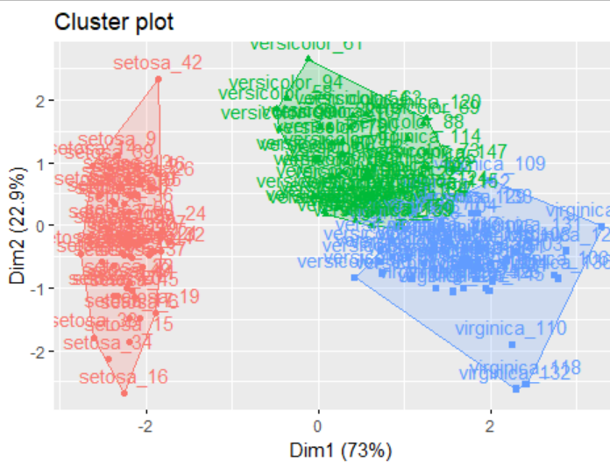
K-mean Clustering Applied
R walkthrough of Iris data set⁵
^{3 clear classes}
% describes how much of that dimension describes the data

Slide 9
Changing Data
Scale data
Increases accuracy by transforming all the data to be on a certain scale such as -1 to 1, 0 to 100, etc.
Uniform range for all attributes
Convert swing data to Swinging Strike Rate
SwStrPct = whiffs / (swings + takes) * 100%
ISO (isolated power = slg – ba) made little impact on model

Slide 10
K-means Clustering steps
Scale data
Choose number clusters using elbow method (checked gap stat and silhouette methods)
Creating and visualizing clusters by first two principal components
Created box plots of salary for each cluster to compare
Created starter lists based on this clustering of potentially over and under-valued players

Slide 11
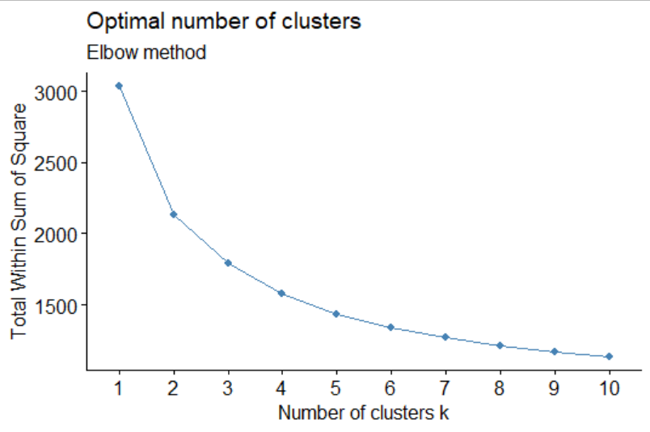
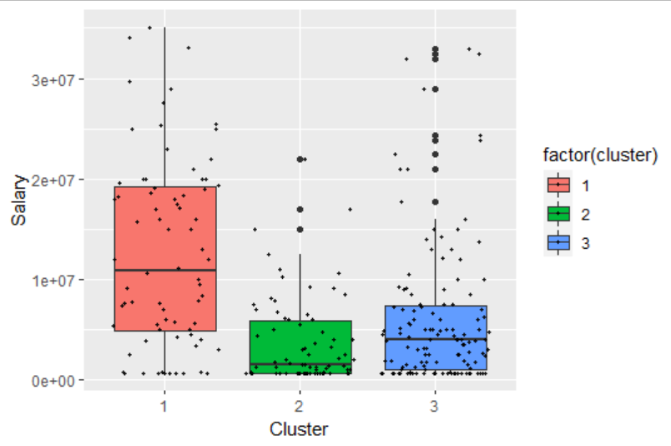
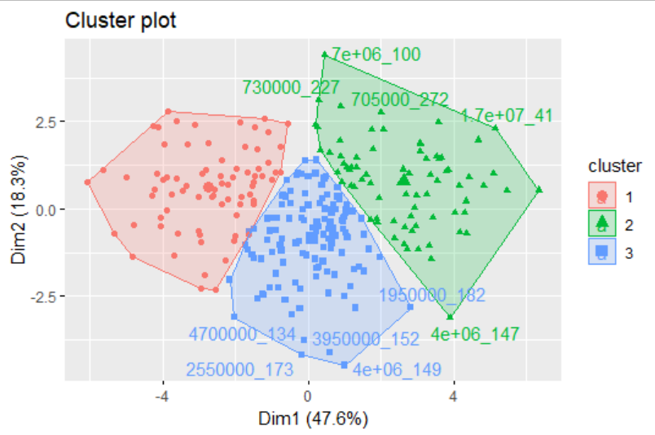
K-means Visualizations

Slide 12
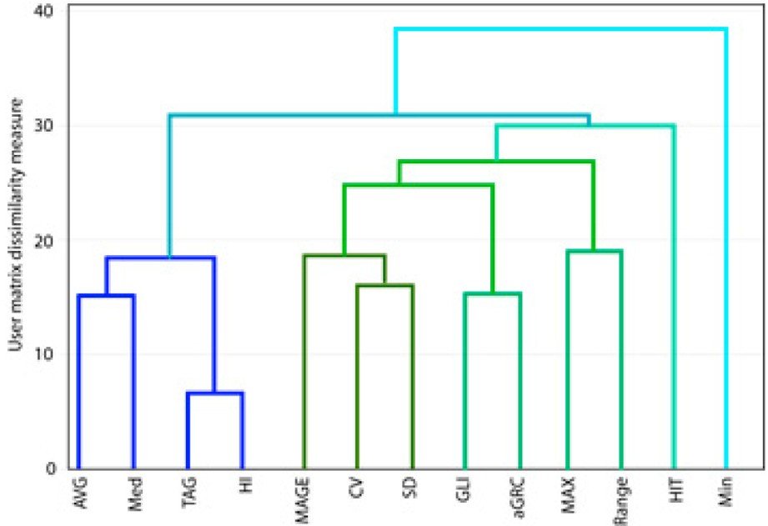
Hierarchical Clustering
Unsupervised learning
Do not need to specify number of clusters beforehand
Process: ⁶
Calculate and create a distance matrix of dissimilarities between each observation in the dataset
Fuse observations into clusters, connecting two most similar points at each step into one cluster until there is one large cluster that can be plotted as a dendrogram tree
Methods used to determine similarity between two points:
Complete linkage clustering
Single linkage clustering
Mean linkage clustering
Centroid linkage clustering
Ward’s minimum variance method: Minimize the total sum of square error

Slide 13
Hierarchical Clustering steps
Scale data
Find best clustering linkage method using agglomerative coefficients(AC) of each method
AC describes the strength of clustering structure
Choose number clusters (4) using gap stat and thumb rule of dendrogram
Fit hierarchical model using Euclidean distance matrix and plot dendrogram
Cut data into 4 clusters
Create box plot and observe mean stats for each cluster
Create list of under-valued players using this clustering algorithm and research the top players to target based on contract status

Slide 14
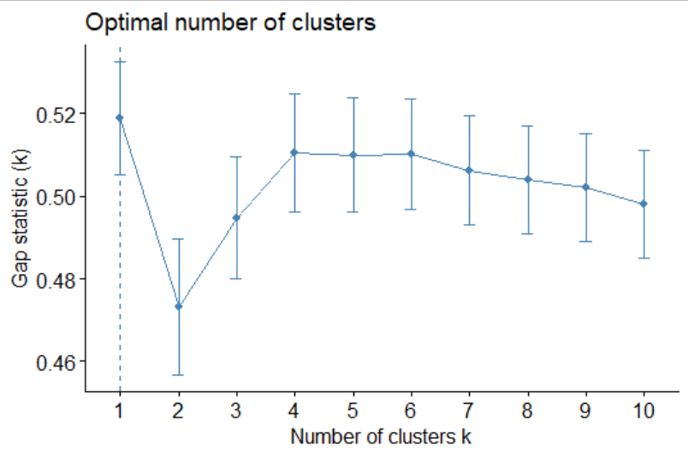
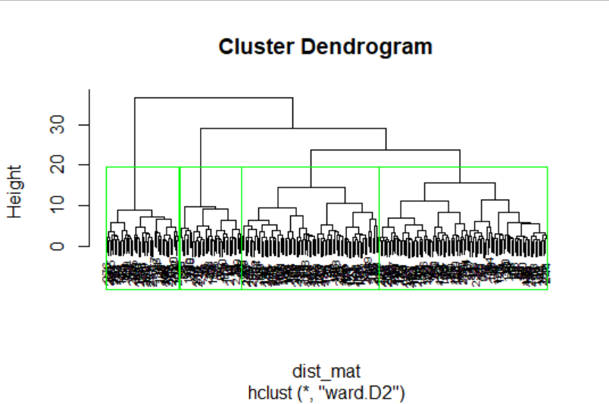
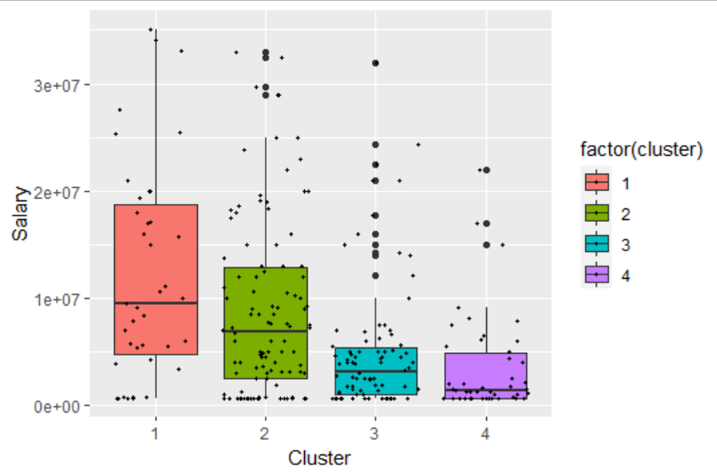
Hierarchical Visualizations

Slide 15
R Tutorial and Results
Avoided many players for several reasons: arbitration, retirement, deferred contracts
CJ Cron – $7.25mil for 2 years, could be a good short-term pickup for two years security at first base, especially if 1B prospect is coming up soon
Luis Robert – increasing contract to $15mil by 2025 with $20mil club options for 2026-2027, in his prime years, centerfielder
Jed Lowrie – $850k for one year, cheap utility veteran that still hit league average in 2021 but is at risk for age regression

Slide 16
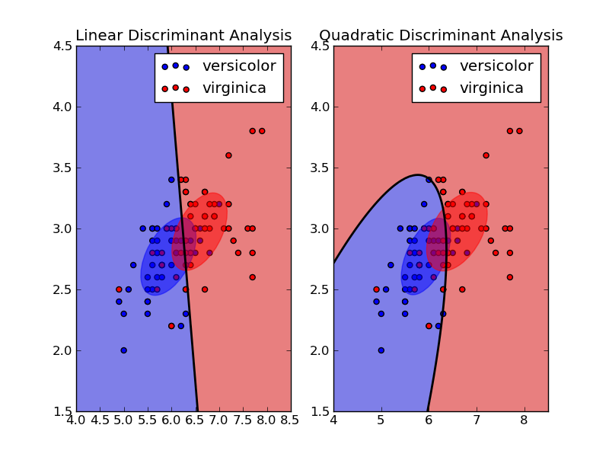
Vector Machines ⁷
Linear Discriminant Analysis (LDA):
transform high dimensional data into one dimension where a boundary line is optimized to separate data into classes
requires normal groups and identical covariance matrices
Quadratic Discriminant Analysis (QDA):
Non-linear boundary
No required assumptions

Slide 17
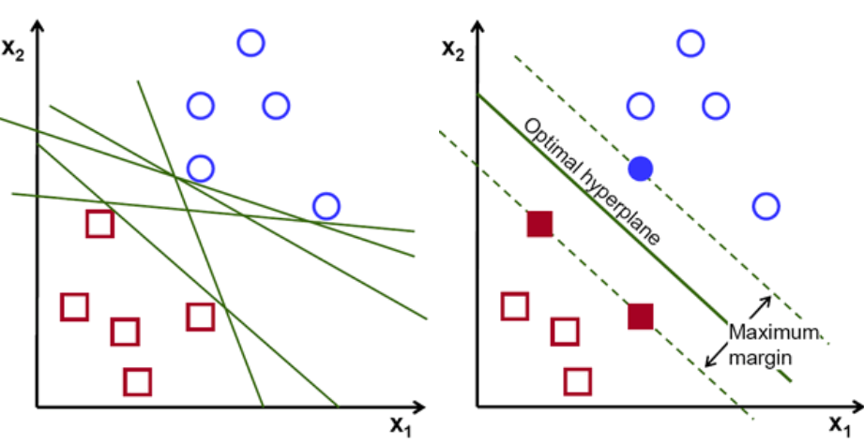
Support Vector Machine (SVM):
Maximize margin of separation between groups
Use non-linear functions to transform/change the shape of the data
Requires no assumptions

Slide 18
Further Data Transformations
Grouped into 5 salary groups:
< $1 million
$1-5 million
$5-15 million
$15-25 million
> $25 million
Data automatically scaled

Slide 19
SVM Steps
Test for normality with Shapiro-Wilkes Normality test
slg, xwoba, hits, abs not normally distributed
Perform LDA, QDA, and SVM with all features and only normal features (although only LDA requires normality)
Compare accuracy values of confusion matrices
Find the players with very high salary group prediction, but low true salary group

Slide 20
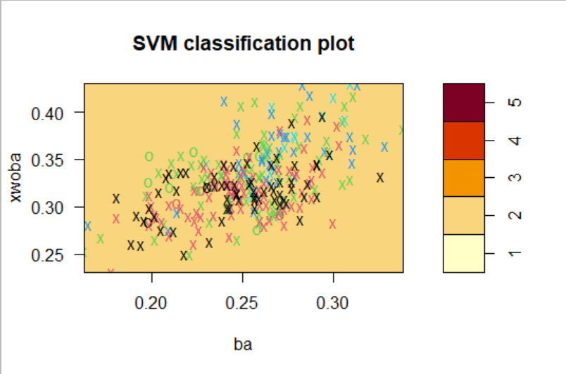
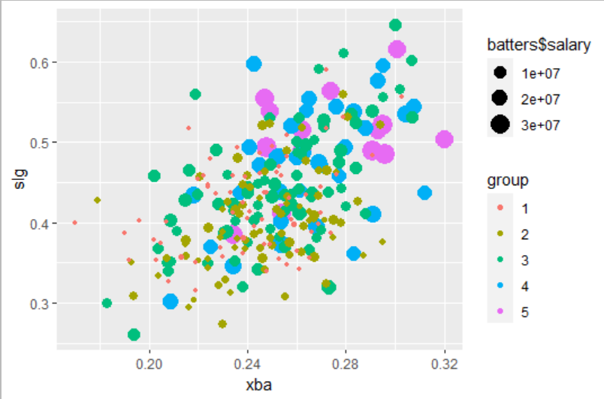
SVM Tutorial
Final model accuracy: 84.12%

Slide 21
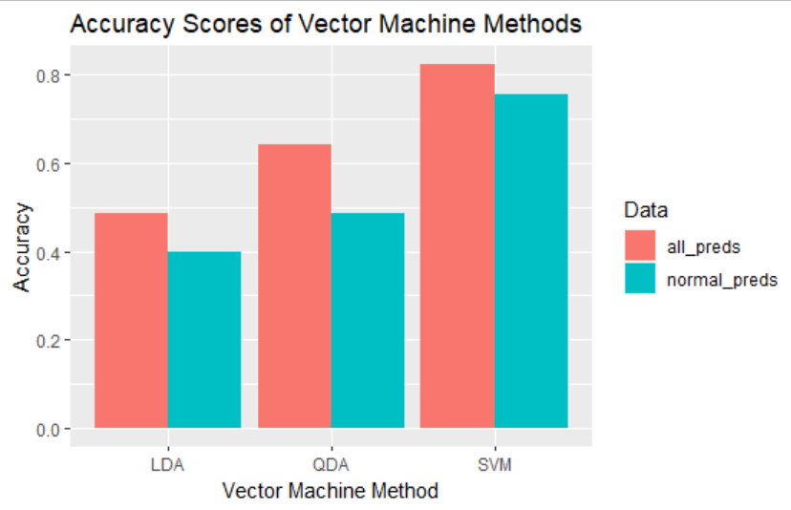
SVM Results
LDA – 48.74% / 39.71%
QDA – 64.26% / 48.74%
SVM – 82.31% / 75.45%

Slide 22
Resulting Players to Research
Predicted group 4 actually group 1: Will Smith, Mountcastle
Predicted group 4 actually group 2: Adames, Bryan Reynolds, Austin Riley
Predicted group 3 actually group 1: Lowrie, Toro, Sean Murphy, Vaughn, Dylan Carlson
Groups:
1 – $0-1 million
2 – $1-5 million
3 – $5-15 million
4 – $15-25 million
5 – $25+ million

Slide 23
Takeaways
For pre-arbitration and arbitration players, this may be a starting point for extensions to save on future years
Given my use of salaries already based on the previous year's stats, this would be most helpful to target players in trades in the year 2022, as the player is locked into that contract already
Some common undervalued results from models were Jed Lowrie, Willy Adames, Bryan Reynolds, Austin Riley, Ryan Mountcastle
More research should be put into decision making obviously, such as the factors considered for Luis Robert and C.J. Cron, however, this is purely to show the power of basic machine learning models in salary and performance evaluation

Slide 24
Further Possibilities
Potential to classify future players based on this type of model into salary range, based on performance
To predict actual salary values and not groups, regression must be used, not classification
Consider a situation where we don't have salaries. Predict based on raw stats and then find the performers in each group that are abnormally low in traditional statistics, as they are likely to improve in the future

Slide 25
What I Learned
The importance and time-consumption of finding and cleaning good data
Current uses of machine learning in baseball models and predictions
What type of baseball data is public and not
New algorithms, their implementation, and the associated processes necessary to build those models (selecting methods, choosing number of clusters, etc.)
K means clustering
Hierarchical clustering
Vector Machines (LDA, QDA, SVM)
Types of visualizations useful for these analyses

Slide 26
Works Cited
1 – Major League Baseball Salaries 2022 | USA TODAY Databases | USA TODAY NETWORK
2 – Statcast Search | baseballsavant.com (mlb.com)
3 – Baseball_Machine_Learning.pdf (miamioh.edu)
4 – Using Machine Learning Algorithm to (stanford.edu)
5 – Applied K-Means Clustering in R – YouTube
6 - Hierarchical Clustering in R: Step-by-Step Example – Statology
7 - Understanding and Applying Vector Machines in R (SVM, LDA, QDA) - YouTube

